Slide 1
Blinn College Associate Degree Nursing Program
Generic Option
Orientation

Slide 2
Blinn Associate Degree Nursing Program
Blinn College, main campus, Brenham, TX
ADN Program, main campus, Bryan, TX
Generic (Bryan) and LVN-Transition Program (Bryan & Brenham)
Accredited by ACEN
National Accreditation

Slide 3
LVN, ADN, BSN??
Licensed Vocational Nurse (LVN)
1 year program (Blinn offers this program in Bryan, Brenham and online/weekend)
Receive a certificate after completion
Take NCLEX-PN
Receive LVN license
Most jobs at long term care settings (ex. Nursing Homes), Physician Offices, Home Health
Associate Degree Nursing (ADN)
2 year (plus preqs) program
or
LVN-RN Transition (1 year additional classes after LVN, Blinn offers this program)
Receive an Associate of Applied Science degree after completion
Take NCLEX-RN
Receive RN license
Many jobs at acute care facilities (hospitals), plus many more!
Bachelors of Science degree in Nursing (BSN)
4 year degree (2 years prereqs, plus 2 years of nursing classes)
or
RN-BSN (1 year additional classes after ADN, many programs available, often online)
Receive a Bachelors of Science degree in Nursing
Take NCLEX-RN
Receive RN license
Many jobs at acute care facilities (hospitals), plus many more!

Slide 4
Completion Rates
 | Graduates | Eligible | Completion Rate Percentage
Generic Dec 2016 | 39 | 46 | 84.78%
LVN-T Dec 2016 | 4 | 5 | 80.00%
Generic May 2017 | 50 | 57 | 87.72%
LVN-T May 2017 | 17 | 20 | 85.00%
Generic Dec 2017 | 26 | 45 | 57.77%
LVN-T Dec 2017 | 1 | 2 | 50.00%
Generic May 2018 | 56 | 64 | 87.50%
LVN-May 2018 | 21 | 22 | 95.45%

Slide 5
NCLEX-RN Pass Rates
 | Total Cohort | Traditional/Generic Cohort | LVN Cohort | Bryan LVN Cohort | Schulenburg LVN Cohort | Brenham LVN Cohort
0512 (n=51) | 92.15% (47/51) | 89.2% (33/37) | 100% (14/14) | 100% (6/6) | 100% (8/8)
1212 (n=42) | 78% (33/42)
0513 (n=49) | 87.75% (43/49) | 87.5% (35/40) | 88.89% (8/9) | 100% (5/5) | 75% (3/4)
1213 (n=46) | 82.6% (38/46)
0514 (n=56) | 90.9% (50/55) | 90% (36/40) | 93.75% (15/16) | 100% (11/11) | 80% (4/5)
1214 (n=44) | 81.82% (36/44) | 81.82% (36/44)
0515 (n=42) | 95.24% (40/42) | 93.55% (29/31) | 100% (11 /11) | 100% (11 /11)
1215 (n=39) | 94.74% (36/38)* | 94.44% (34/36) | 100% (2/2) | 100% (2/2)
0516 (n=41) | 97.56 % (40/41) | 96.55% (28/29) | 100% (12/12) | 100% (12/12)
1216 (n=40) | 92.68% (38/41)* | 91.89% (34/37) | 100% (4/4) | 100% (4/4)
0517 (n=50) | 96% (48/50) | 92% (46/50) | 100% (13/13) | 100% (13/13) |  | 100% (4/4)
1217 (n=27) | 100.0% (27/27) | 100.0% (26/26) | 100% (1/1) | 100% (1/1)
0518 (n-53) | 94.34% (50/53) | 94.29% (33/35) | 95.24% (20/21)
91.49%
(387 passed/423 graduates), Last 5 years

Slide 6
Job Placement Rates
A | B | C | D | E | F | G | H | I
Grad Year | # of Grads in cohort | # of Grads with known or Reported Status | Employed before 12 months* | % employed | INS Issues/ green card status | Not Seeking employment | BON Issues | Eligible and seeking employment
2012 May | 51 | 47 | 46 | 98% |  | 1 |  | 100%
2012 Dec | 42 | 39 | 33 | 85% | 2 | 3 |  | 97%
2013 May | 49 | 47 | 45 | 96% |  |  | 2 | 96%
2013 Dec | 46 | 45 | 44 | 98% |  |  |  | 98%
2014 May | 57 | 52 | 50 | 96% |  |  | 2 | 96%
2014 Dec | 44 | 41 | 40 | 98% |  | 1 |  | 100%
2015 May | 42 | 38 | 36 | 95% |  | 2 |  | 100%
2015 Dec | 39 | 36 | 35 | 97 % |  |  | 1 | 100%
2016 May | 41 | 34 | 34 | 100% |  |  |  | 100%
2016 Dec | 40 | 38 | 38 | 100% |  | 1 |  | 100%
2017 May | 50 | 48 | 47 | 97.92% |  | 1 |  | 100%
2017 Dec | 27 | 27 | 26 | 96% | 1 |  |  | 100%
2018 May | 56 | 54 | 53 | 98.15% |  |  | 1 | 100%
Column C- students who have reported their employment or non-employment status to the faculty via-survey's, social media, hospital contacts Column D- students who secured employment 12 months after graduation Column E- Percentage of Students employed not taking into account those not eligible or seeking employment Column F- INS Issues- green card, visa status Column G- Not seeking employment due to life circumstances babies, deaths, moving, enrolled in BSN Column H- Declaratory orders not cleared within 12 months of graduation; OR failed boards times Column I-Eligible & wanting to work as RN
Notes:
Employment rate as of 5/21/2018

Slide 7
Generic Option Program
Admits twice per year in Fall and Spring
Bryan only (admits approximately 40-50 students with each class)
Upon Completion:
Earn Associates Degree
Eligible to apply to take Registered Nurse license exam (NCLEX-RN)

Slide 8
FAQ Admissions Questions
How many students normally apply?
120 students
What is the average admitted GPA of the admitted student?
The average GPA of the admitted student is 3.41
What is the average TEAS score of the admitted student?
The average TEAS score of the admitted student is 83.43
*Based on past two years

Slide 9
Admissions Requirements
Steps to Complete:
Complete Application to Blinn College (need Blinn ID #)
Complete Blinn Generic Application (paper application) from website
Applications Due Mid September for Spring/mid March for Fall (Specific due date on website)
(ALL ITEMS MUST BE SUBMITTED BY DEADLINE to CONSIDERED)

Slide 10
Admissions Requirements
Transcripts
ALL official transcripts are required to be submitted with your application
Requirement to establish how many total college credit hours you have received in total

Slide 11
Admissions Requirements
Transcript FAQ
Can I submit an unofficial transcript? No
Can I submit a picture of an official transcript? No
How will you know it is an official transcript? We have our ways ☺
How do I get them? Go to the college/university website, and there are generally instructions on how to pick-up or have mailed transcripts
If I am going to have them mailed where should they be mailed to? Have them mailed to YOUR address, addressed to you. If the college/university will not do this, contact Ms. Brandi Brown for instructions
What do we do with the transcripts once we get them? You will open them up and highlight the courses you have taken in the nursing degree plan (this helps us expedite the process)
But the on the official transcript envelope it says I can’t open them, or they will no longer be official…? We give you permission to open them
How long does it take to get transcripts in? It varies from college to college, but some have taken over 4-6 weeks, so do not wait until the last minute, or you might end up having to drive to go pick them up

Slide 12
Admissions Requirements
Be Texas Success Initiative (TSI) Compliant
Many students can be waived by ACT, SAT, TAKS, STAAR scores, or previous coursework, previous degree, etc.
If not waived, will be required to take assessment prior to admissions, might need to take other classes

Slide 13
Admission Requirements
Take Prerequisite Classes- “C” or higher
BIOL 2401- A&P 1
BIOL 2420- Microbiology (Prereq: BIOL 2401)
All must be current, within 5 years.
If A&P 1 (and A&P 2, which is a corequisite) are expired, can take BIOL 2404- Intro to A&P as refresher course

Slide 14
Admission Requirements
Take Prerequisite Classes-“C” or higher
ENGL 1301 or 1302- English
PSYC 2301- General Psychology

Slide 15
Admissions Requirements
Overall minimum GPA on courses taken in degree plan upon admissions: 2.5

Slide 16
Admissions Requirements
Priority for admissions will be given to those students who have all prerequisite courses completed at the time of application.
Other highly competitive candidates will be considered for conditional admissions for the current admissions cycle and wait-list admissions for the following admissions cycle.

Slide 17
Admissions Requirements
Are you ready for Distance Learning?
Smarter Measure
Online assessment tool to help you learn about yourself and distance learning and help you succeed. Assesses strengths/weakness in 5 areas:
Individual Attributes: Procrastination, Time Management, etc.
Learning Styles
Reading Rate and Recall
Typing Speed and Accuracy
Life Factors
Ecampus Tutorials
Distance Learning Help Desk (979) 209-7298

Slide 18
Admission Requirements
Take ATI TEAS Exam
A computerized test with 4 individually timed parts: Reading: 64 minutes (53 questions) Mathematics: 54 minutes (36 questions) Science: 63 minutes (53 questions) English: 28 minutes (28 questions)
$10-$15 Testing Fee & $58 Exam Fee
Retesting Waiting Period: 4 weeks
LOCATION: M-F, 3125 South Texas Ave, behind the H.E.B.
WHEN: Walk-in testing, M-F, 8:00 AM and no later than 11:00 AM, No Walk-In Testing on Saturdays

Slide 19
ATI TEAS Study Guides
ATI TEAS Secrets Study Guide- $28.70
ATI TEAS Test Study Guide 2018-2019- $26.59
ATI TEAS 6 Study Guide 2018- $26.59

Slide 20
ATI TEAS Study Guides
ATI TEAS SmartPrep study package- $209.00
90 day access to modules
65 lessons across 4 subjects
650 practice questions
Focused remediation
Study manual

Slide 21
Admissions Requirements
ATI TEAS
Overall Categories
Exemplary
Advanced
Proficient
Basic
Developmental
We will not consider students with Basic & Developmental for admissions

Slide 22
Admissions Requirements
Courses Completed
Receive 1 point for every course (prerequisite and corequisites completed)
Up to 7 points
Bonus Point
Pathophysiology (HPRS 2301)
Get 1 EXTRA point if take and receive an A or B

Slide 23
Admissions Rankings Table
Generic Admissions Rating Scale: | Maximum Points:
^GPA (Average GPA of completed required academic courses X 5) | 20
Required courses completed (7 academic courses required- 1 point each) | 7
**TEAS Academic Preparedness Category: Proficient (2), Advanced (4), Exemplary (6) | 6
Note: “Developmental & Basic” is disqualifying for the program
**TEAS Reading (1 point if at or above program cut score 76, 0 if below) | 1
**TEAS Math (1 point if at or above program cut score 75, 0 if below) | 1
**TEAS Science (1 point if at or above program cut score 66, 0 if below) | 1
**TEAS English (1 point if at or above program cut score 70, 0 if below) | 1
BONUS: HPRS 2301 (Patho Bonus Point) (Completed with an A or B) | +1
TOTAL POSSIBLE POINTS | 37+1
^Note: GPA is average of courses taken in degree plan from past 5 years
*Note: TEAS Points must all come from SAME TEAS attempt*

Slide 24
What Can I Do to Make my Application Better?
Take the all the corequisites Courses
Take HPRS 2301-Pathophysiology and score B or higher (+1 point)
Retake ATI TEAS
Retake Courses for higher GPA (Note: grades from courses in degree plan from past 5 years AVERAGE into GPA)

Slide 25
Admissions Requirements
Immunizations
TB screening (do not get until within 30 days of program)
TDAP (booster within 10 years)
MMR (show 2 doses or a titer WITH + immunity for each) (2 doses must be 4-6 weeks apart)
Varicella (show 2 doses or titer WITH + immunity)
(2 doses must be 4-6 weeks apart)
Influenza (Will not need to get until October-flu season)
Meningococcal (<22 years old MANDATORY by College)
Hepatitis B….

Slide 26
Admissions Requirements
Hepatitis B
3 shot series, 6 month series (younger than 30s received as a infant otherwise you are required to get to work in healthcare)
Must show positive, quantitative Hepatitis Surface Antibody (>10 mIU/mL)
If Positive: Do not need any proof of shots- positive lab is sufficient.
If Negative: Need record of completion of 3 shot series, and must restart series.
**NOTE: If your titer is not positive, and you are unable to find your records to prove you have had the first 3 shots, you may not be able to enter the program for your desired semester as this is a requirement by the clinical agencies.**

Slide 27
Admissions Requirements
Students whose first/native language is not English (ESL), are required to take the TOEFL iBT Test, regardless of US education, or years of residence.
Cannot be older than 2 years
A minimum score of 83 on the Internet Based Test (iBT), with a minimum of 20 in reading, 20 in writing, 20 in speaking, and 20 in listening.

Slide 28
Admissions Requirements
Clear Drug Screen- Wait! Until we tell you when/where to go
CPR Certification
American Heart Association or Red Cross Basic Life Support (BLS) (2 year renewal)
MUST have hands-on component, NOT just online course
MUST say for BLS for “Health Care Provider”

Slide 29
Admissions Requirements
Criminal Background Check- Texas Board of Nursing
Required for all incoming students
After application due date, will get an email from IdentiGo to start the process
Does not guarantee acceptance into the program, but still need to get the process started

Slide 30
Texas Board of Nursing Licensure Eligibility Questions
Been convicted of a misdemeanor?
Been convicted of a felony?
Pled nolo contendere, no contest, or guilty?
Received deferred adjudication?
Been placed on community supervision or court-ordered probation, whether or not adjudicated guilty?
Been sentenced to serve jail or prison time or court-ordered confinement?
Been granted pre-trial diversion?
Been arrested or have any pending criminal charges?
Been cited or charged with any violation of the law?
Been subject of a court-martial; Article 15 violation; or received any form of military judgment, punishment, or action?
NOTE: You may only exclude Class C misdemeanor traffic violations

Slide 31
Texas Board of Nursing Licensure Eligibility Questions
Expunged and Sealed Offenses: While expunged or sealed offenses, arrests, tickets, or citations need to be disclosed, it is your responsibility to ensure the offense, arrest, ticket or citation has, in fact, been expunged or sealed. It is recommended that you submit a copy of the Court Order expunging or sealing the record in question to our office with your application. Failure to reveal an offense, arrest, ticket, or citation that is not in fact expunged or sealed, will at a minimum, subject your license to a disciplinary fine. Non-disclosure of relevant offenses raises questions related to truthfulness and character.

Slide 32
Texas Board of Nursing Licensure Eligibility Questions
Orders of Non-disclosure: Pursuant to Tex. Gov’t Code § 552.142(b), if you have criminal matters that are the subject of an order of non-disclosure you are not required to reveal those criminal matters on this form. However, a criminal matter that is the subject of an order of non-disclosure may become a character and fitness issue. Pursuant to other sections of the Gov’t Code chapter 411, the Texas Nursing Board is entitled to access criminal history record information that is the subject of an order of non-disclosure. If the Board discovers a criminal matter that is the subject of an order of non-disclosure, even if you properly did not reveal that matter, the Board may require you to provide information about that criminal matter.

Slide 33
Texas Board of Nursing Licensure Eligibility Questions
Are you currently the target or subject of a grand jury or governmental agency investigation?
Has any licensing authority refused to issue you a license or ever revoked, annulled, cancelled, accepted surrender of, suspended, placed on probation, refused to renew a license, certificate or multi-state privilege held by you now or previously, or ever fined, censured, reprimanded or otherwise disciplined you? (You may exclude disciplinary actions previously disclosed to the Texas Board of Nursing on an initial or renewal licensure application)

Slide 34
Texas Board of Nursing Licensure Eligibility Questions
*In the past five (5) years have you been diagnosed with or treated or hospitalized for schizophrenia and/or psychotic disorder, bipolar disorder, paranoid personality disorder, antisocial personality disorder, or borderline personality disorder which impaired or does impair your behavior, judgment, or ability to function in school or work? (You may answer “No” if you have completed and/or are in compliance with TPAPN for mental illness OR you’ve previously disclosed to the Texas Board of Nursing and have remained compliant with your treatment regime and have no further hospitalization since disclosure.)

Slide 35
Texas Board of Nursing Licensure Eligibility Questions
*In the past five (5) years, have you been addicted or treated for the use of alcohol or any other drug? (You may answer "No" if you have completed and/or are in compliance with TPAPN)

Slide 36
Admissions Requirements
Texas House Bill 1508: In accordance with Texas House Bill 1508 all applicants in pursuit of an occupational degree with licensure must be notified of potential ineligibility. Admission to and/or completion of the Associate Degree Nursing Program does not ensure licensure eligibility. Eligibility to sit for the registered nurse licensure exam NCLEX-RN is determined by the Texas Board of Nursing (BON). Issues that could lead to ineligibility could include but are not limited to certain criminal offenses, substance abuse and mental health illnesses. Please note, a student’s eligibility may be affected by any inaccuracies in their petition, and any subsequent violation of the Nursing Practice Act may affect eligibility or may result in the later revocation of a license obtain through misrepresentation. Please refer to the Texas Board of Nursing site for specifics (http://www.bon.texas.gov/licensure_eligibility.asp).

Slide 37
FAQ Admissions Questions
When will I know if I get in?
Approximately 3-4 weeks after application are due you will get notification of:
1) Provisional acceptance for semester applied to
2) Alternate list placement
3) Provisional acceptance for following semester (for those highly qualified but have prerequisites in progress)
Students who are ineligible, will be notified in Sept/March

Slide 38
FAQ Admissions Questions
Do we consider work experience? Letters of Recommendation? Resume? Interview?
No, we only go off of the Rankings Table

Slide 39
Expenses
 | Tuition (Out-Of District) & General Fee | Health Science Center Fee | Testing Fee | Liability Insurance | course lab fees
Semester 1 | $ 1,750.00 | $ 300.00 | $ 271.75 | $ 6.50 | $ 105.00 | $ 2,433.25
Semester 2 | $ 1,575.00 | $ 300.00 | $ 228.75 | $ 6.50 | $ 129.00 | $ 2,239.25
Semester 3 | $ 1,750.00 | $ 300.00 | $ 228.75 | $ 6.50 | $ 59.00 | $ 2,344.25
Semester 4 | $ 1,225.00 | $ 300.00 | $ 228.75 | $ 6.50 | $ 35.00 | $ 1,795.25
$ 8,812.00
Other Costs
Parking | $ 300.00/year
Castlebranch (Medical Documents Manager) | $ 30.00
Uniform | $ 80.00
Supplies (Stethoscope, Scissors, Pen Light) | $ 50.00
Hepatitis B (if needed) | $ 100.00
CPR | $ 55.00
Drug Screen | $ 27.00
Books | $ 1,800.00
BCNSA Dues (optional) | $ 10.00
Board of Nursing | $ 100.00
Pearson Vue | $ 200.00
 | $ 2,752.00
Beginning of Program
Approximated Total: $ 11,564.00*
*Approximate without prereq courses
End

Slide 40
Scholarships, Grants, Etc.
Blinn College Foundation Scholarships
Brazos Valley Workforce Solutions
Perkins Grant

Slide 41
Policies
Progression Policy: Grades in nursing courses- Must pass with a “C” to progress to
Grading Policy: Passing is a 75%. Must pass exams (with at least a 75%) before other assignments included in course average
Readmission policy: May re-enter program one time only
Participation policy: expected to attend all classes, at least 10% of grade

Slide 42
Course Layout (Example)
Semester 1- Monday, Tuesday, Wednesday, Thursday
Foundations, Health Assessment, Pharmacology
Semester 2- Tuesday, Wednesday, Thursday, Friday am
AH 1, AH 1 Clinical, Skills 2, Mental Health, Mental Health Clinical
Semester 3- Thursday, Friday & Clinical
Adult Health 2, Adult Health 2 Clinical, Pedi/OB, Pedi/OB Clinical
Semester 4- Friday & Clinical- 10 weeks & Preceptorship (6 weeks)
Adult Health 3, Adult Health 3, Clinical, Management (Online), Preceptorship

Slide 43
Preceptorship
Last 6 weeks of Final Semester
128 hours working with a RN
Can select top 3 choices for preferred specialty
*Actual site for preceptorship dependent on many factors (including clinical site availability, nurse schedules, etc.)
Can be 8, 12 hour shifts, nights, days, weekends

Slide 44
Clinical
Second Semester
RNSG 1260- Adult Health 1 Clinical (96 hours)- (8 hours clinicals)
RNSG 2160- Mental Health Clinical (48 hours)- as scheduled
Third Semester
RNSG 2261- Adult Health 2 Clinical (96 hours)- (8-9 hour clinicals)
RNSG 2161- Pedi/OB Clinical (48 hours)- (8 hour clinicals)
Fourth Semester (10 week course→6 week Preceptorship)
RNSG 2262- Adult Health 3 Clinical (96 hours)- (12 hour clinicals)

Slide 45
Clinical
Acute Care
CHI St. Joseph, Baylor Scott & White- CS & Brenham, College Station Medical Center, St. Mark’s-La Grange, Rock Prairie Behavioral Health
Med/Surg, IMCU, ICU, L&D, NICU, Nursery, Post-Partum, Telemetry, Stroke, Observation, Endoscopy, Cath Lab
Community Settings
Home Health
Hospice
Health Fairs
Clinics
Schools
Dialysis
Simulations

Slide 46
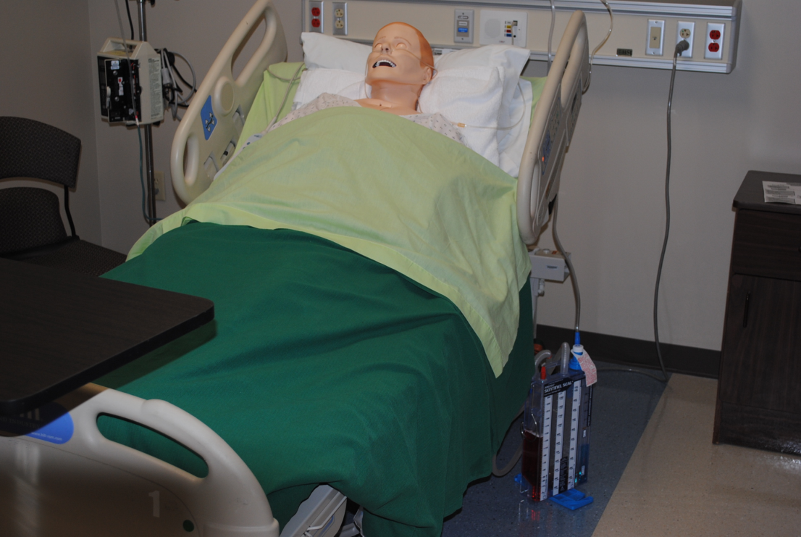
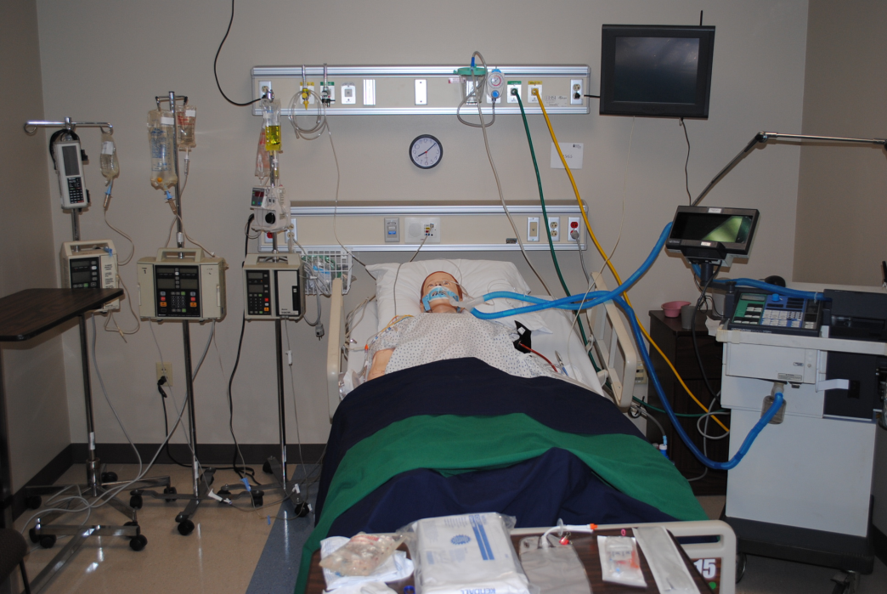
Simulation Center

Slide 47
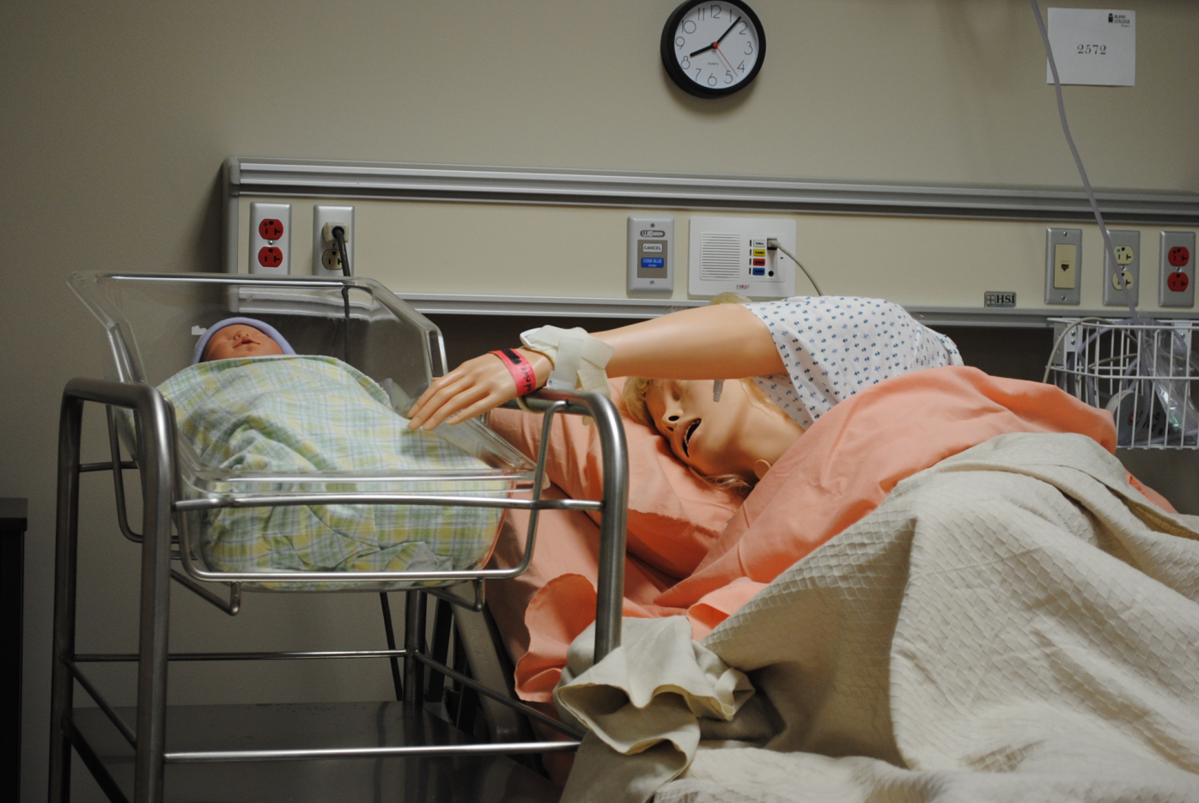
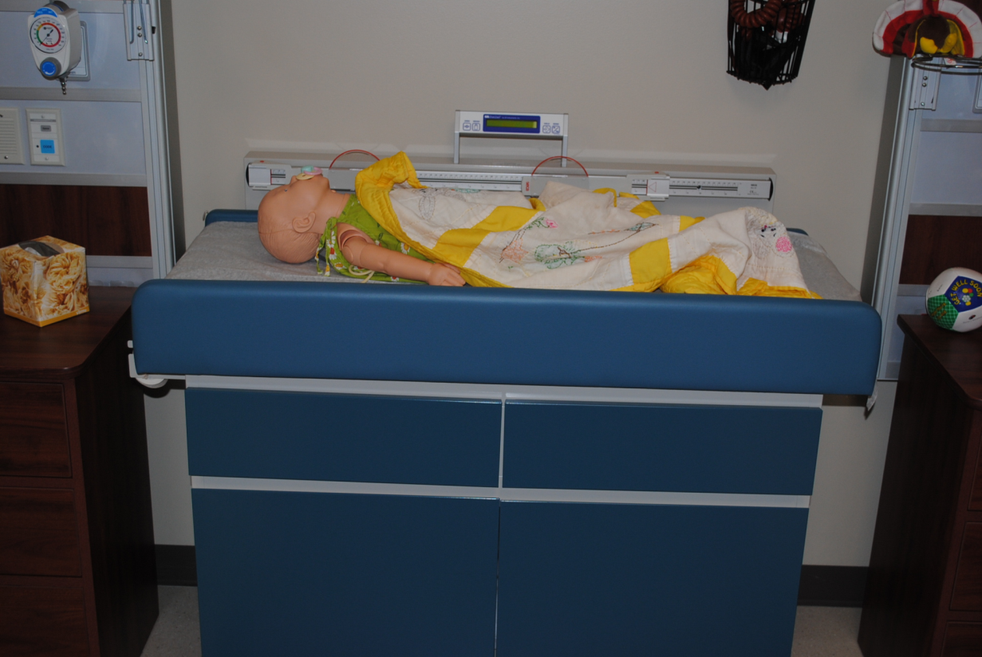
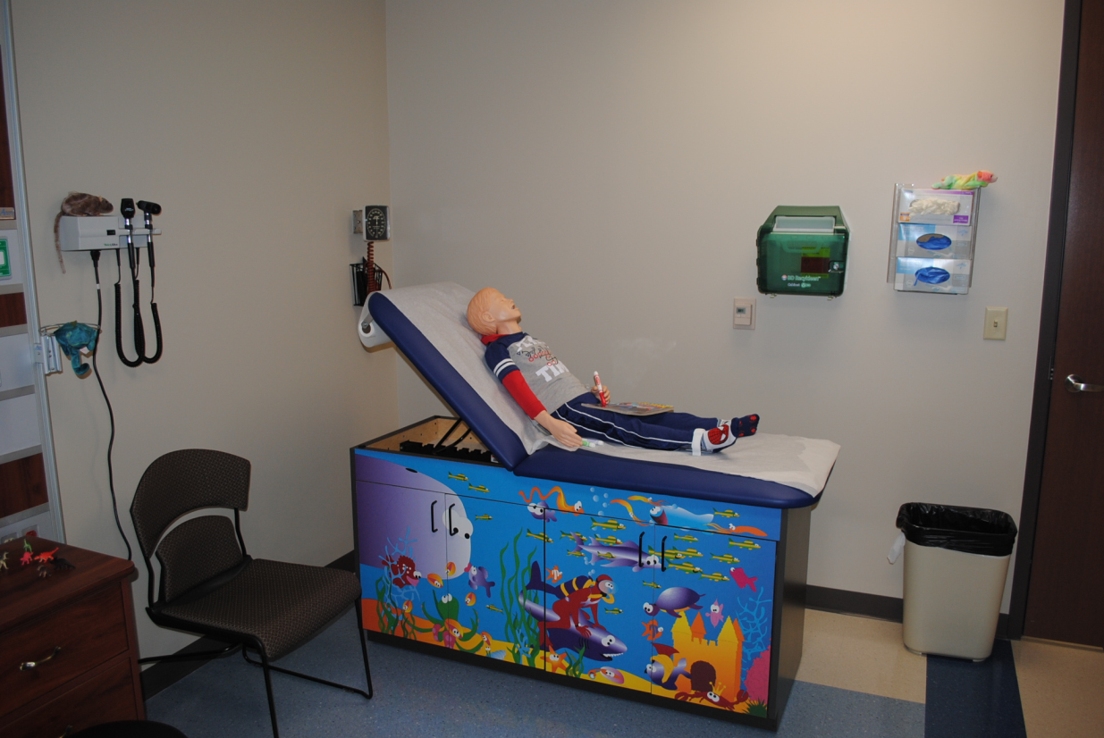

Slide 48
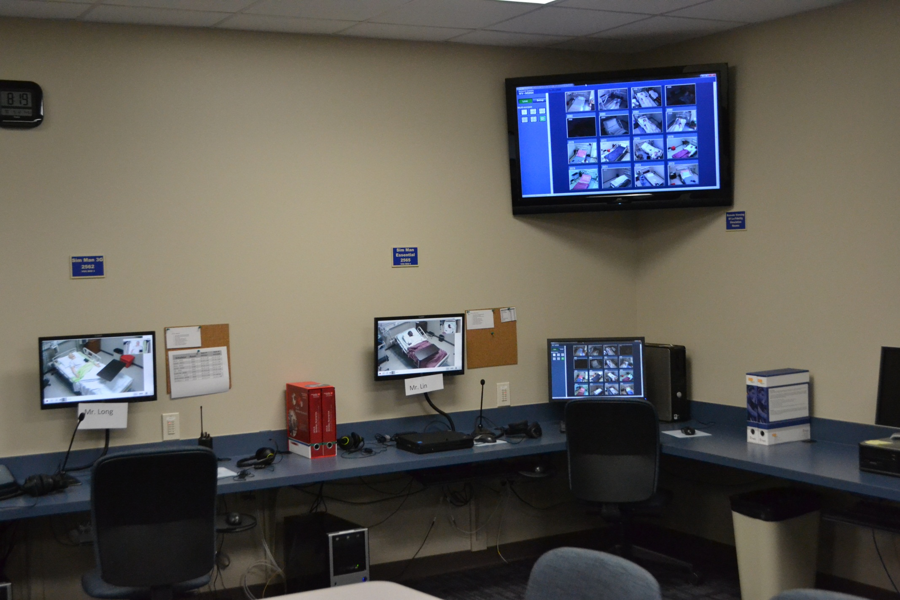

Slide 49
Student Organizations
Alpha Delta Nu- Honor Society
A & Bs in ALL courses in the program & Complete Capstone Project
Blinn College Student Nurses Association
Service Organization (Dues $10/year)

Slide 50
Pinning Ceremony
The Pinning Ceremony is a symbolic welcoming of graduate nurses into the profession of nursing. The nurse is presented with a pin by a loved one, and recite a nurses pledge.

Slide 51
RN Licensure
National Council Licensure Examination (NCLEX-RN)
The NCLEX is developed to measure the minimum knowledge, skills, and abilities required to deliver safe, effective nursing care at the entry level.
Computerized Adaptive Testing, minimum 75 questions- maximum of 265 questions in a 6 hour time period
NCLEX Test Plan

Slide 52
Things You Can Start on NOW
Enroll at Blinn College
Speak to an Advisor- Amy Sireci (HSC) amy.sireci@blinn.edu
Take Prerequisite Courses
Study for the ATI TEAS
Strengthen application: Take Corequisite (Humanties course), HPRS 2301- Pathophysiology
Find MMR, Varicella, Hepatitis B shot records (check with parents, elementary schools, old workplaces)
Restart Hepatitis B series if Quantitative Hepatitis B Surface Antibody is <10
Get CPR (BLS) renewed if necessary

Slide 53
RELLIS Campus
Summer 2019- Moving to RELLIS Campus
Fall 2019- Courses at RELLIS Campus
You will be a Blinn student- just located on the RELLIS campus.

Slide 54
Questions?
Karla Ross
Director, Associate Degree Nursing Program
karla.ross@blinn.edu, 979-691-2016
Cindy Manning
Assistant Director, Associate Degree Nursing Program
cindy.manning@blinn.edu, 979-691-2035

